Slide 1
Graph Data Structure

Slide 2
Graph
A graph is a pictorial representation of a set of objects where some pairs of objects are connected by links. The interconnected objects are represented by points termed as vertices, and the links that connect the vertices are called edges.

Slide 3
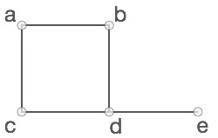
Formally, a graph is a pair of sets (V, E), where V is the set of vertices and E is the set of edges, connecting the pairs of vertices. Take a look at the following graph
In the above graph,
V = {a, b, c, d, e}
E = {ab, ac, bd, cd, de}

Slide 4
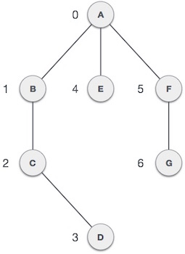
GRAPH

Slide 5
Representation
Mathematical graphs can be represented in data structure. We can represent a graph using an array of vertices and a two-dimensional array of edges

Slide 6
Vertex
Each node of the graph is represented as a vertex. In the following example, the labeled circle represents vertices. Thus, A to G are vertices.

Slide 7
Edge
Edge represents a path between two vertices or a line between two vertices. In the following example, the lines from A to B, B to C, and so on represents edges.

Slide 8
Adjacency
Two node or vertices are adjacent if they are connected to each other through an edge. In the following example, B is adjacent to A, C is adjacent to B, and so on.

Slide 9
Path
Path represents a sequence of edges between the two vertices. In the following example, ABCD represents a path from A to D.

Slide 10
Spanning Tree
A spanning tree is a subset of Graph G, which has all the vertices covered with minimum possible number of edges. Hence, a spanning tree does not have cycles and it cannot be disconnected

Slide 11
Definition
By this definition, we can draw a conclusion that every connected and undirected Graph G has at least one spanning tree. A disconnected graph does not have any spanning tree, as it cannot be spanned to all its vertices.

Slide 12
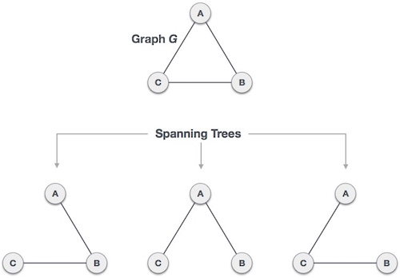
Example

Slide 13
Rules
We found three spanning trees of one complete graph. A complete undirected graph can have maximum n^{n-2} number of spanning trees, where n is the number of nodes. In the above addressed example, n is 3, hence 3³⁻² = 3 spanning trees are possible.

Slide 14
General Properties of Spanning Tree
A connected graph G can have more than one spanning tree.
All possible spanning trees of graph G, have the same number of edges and vertices.
The spanning tree does not have any cycle (loops).
Removing one edge from the spanning tree will make the graph disconnected, i.e. the spanning tree is minimally connected.
Adding one edge to the spanning tree will create a circuit or loop, i.e. the spanning tree is maximally acyclic.

Slide 15
Application of Spanning Tree
Spanning tree is basically used to find a minimum path to connect all nodes in a graph. Common application of spanning trees are −
    Civil Network Planning
    Computer Network Routing Protocol
    Cluster Analysis

Slide 16
Minimum Spanning Trees
Prim’s Algorithm
Similar to Dijkstra’s Algorithm
Kruskal’s Algorithm
Focuses on edges, rather than nodes

Slide 17
Definition
A Minimum Spanning Tree (MST) is a subgraph of an undirected graph such that the subgraph spans (includes) all nodes, is connected, is acyclic, and has minimum total edge weight

Slide 18
Prim's Spanning Tree
Prim's algorithm to find minimum cost spanning tree (as Kruskal's algorithm) uses the greedy approach. Prim's algorithm shares a similarity with the shortest path first algorithms.

Slide 19
Prim's algorithm, in contrast with Kruskal's algorithm, treats the nodes as a single tree and keeps on adding new nodes to the spanning tree from the given graph.

Slide 20
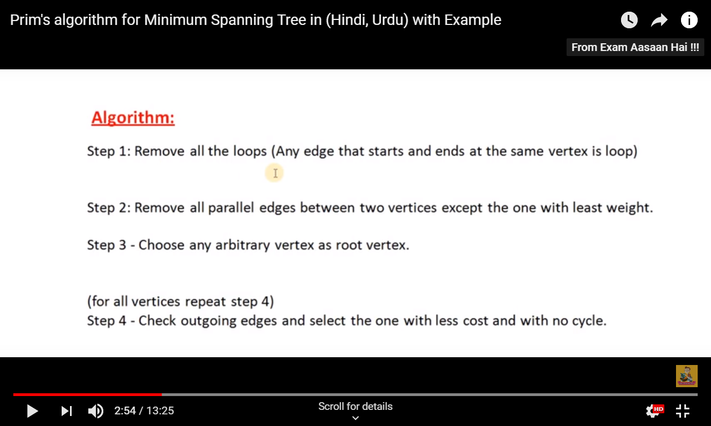
Prim’s Algorithm

Slide 21
Prim's algorithm
PrimMST(graph G)
for each vertex v in G:
v.distance = infinity
start = arbitrary vertex
start.distance = 0
priorityQueue = all vertices in G
while priorityQueue is not empty:
u = vertex with smallest distance in priorityQueue
remove u from priorityQueue
for each neighbor v of u:
if v is in priorityQueue and weight(u, v) < v.distance:
v.distance = weight(u, v)
v.parent = u
return MST

Slide 22
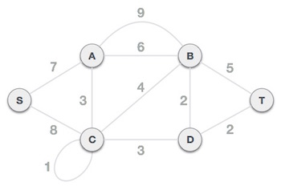
Example

Slide 23
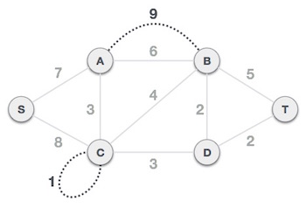
Step 1 - Remove all loops and parallel edges

Slide 24
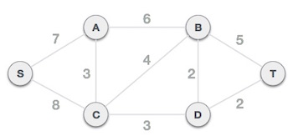
Step 2 - Choose any arbitrary node as root node

Slide 25
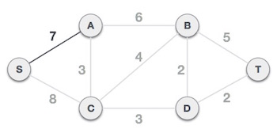
Step 3 - Check outgoing edges and select the one with less cost

Slide 26
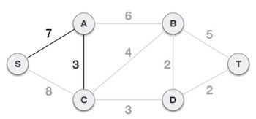

Slide 27
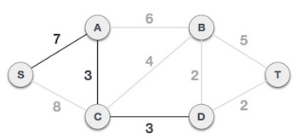

Slide 28
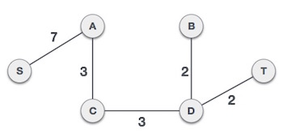

Slide 29
Application
Computer Networks
Travelling salesman problem

Slide 30
Kruskal's Spanning Tree
Kruskal's algorithm to find the minimum cost spanning tree uses the greedy approach. This algorithm treats the graph as a forest and every node it has as an individual tree. A tree connects to another only and only if, it has the least cost among all available options and does not violate MST properties.

Slide 31
Kruskal’s Algorithm
create a forest F (a set of trees), where each vertex in the graph is a separate tree
create a set S containing all the edges in the graph
while S is nonempty and F is not yet spanning
  remove an edge with minimum weight from S
  if the removed edge connects two different trees then add it to the forest F, combining two trees into a single tree

Slide 32
Example

Slide 33
Step 1 - Remove all loops and Parallel Edges

Slide 35

Step 2 - Arrange all edges in their increasing order of weight

Slide 36
Step 3 - Add the edge which has the least weightage
Now we start adding edges to the graph beginning from the one which has the least weight. Throughout, we shall keep checking that the spanning properties remain intact. In case, by adding one edge, the spanning tree property does not hold then we shall consider not to include the edge in the graph.

Slide 37
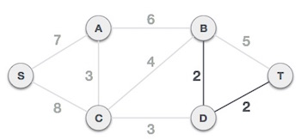
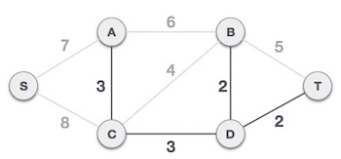

Slide 38
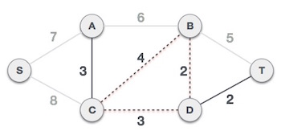
Next cost in the table is 4, and we observe that adding it will create a circuit in the graph.
We ignore it. In the process we shall ignore/avoid all edges that create a circuit.

Slide 39
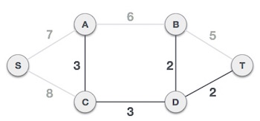
We observe that edges with cost 5 and 6 also create circuits. We ignore them and move on.

Slide 40
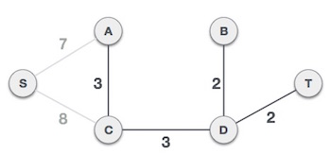

Slide 41
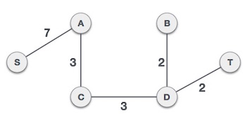
By adding edge S,A we have included all the nodes of the graph and we now have minimum cost spanning tree.

Slide 42
Algorithm Characteristics
Both Prim’s and Kruskal’s Algorithms work with undirected graphs
Both work with weighted and unweighted graphs but are more interesting when edges are weighted
Both are greedy algorithms that produce optimal solutions

Slide 43
Prim’s Algorithm
Similar to Dijkstra’s Algorithm except that d_{v} records edge weights, not path lengths

Slide 44
Walk-Through
2
Initialize array
F
3
C
 | K | d_{v} | p_{v}
A | F | ∞ | −
B | F | ∞ | −
C | F | ∞ | −
D | F | ∞ | −
E | F | ∞ | −
F | F | ∞ | −
G | F | ∞ | −
H | F | ∞ | −
10
A
7
3
8
4
4
B
18
D
9
10
H
2
25
3
G
E
7

Slide 45
2
Start with any node, say D
F
3
C
 | K | d_{v} | p_{v}
A
B
C
D | T | 0 | −
E
F
G
H
10
A
7
3
8
4
4
B
18
D
9
10
H
2
25
3
G
E
7

Slide 46
2
Update distances of adjacent, unselected nodes
F
3
C
 | K | d_{v} | p_{v}
A
B
C |  | 3 | D
D | T | 0 | −
E |  | 25 | D
F |  | 18 | D
G |  | 2 | D
H
10
A
7
3
8
4
4
B
18
D
9
10
H
2
25
3
G
E
7

Slide 47
2
Select node with minimum distance
F
3
C
 | K | d_{v} | p_{v}
A
B
C |  | 3 | D
D | T | 0 | −
E |  | 25 | D
F |  | 18 | D
G | T | 2 | D
H
10
A
7
3
8
4
4
B
18
D
9
10
H
2
25
3
G
E
7

Slide 48
2
Update distances of adjacent, unselected nodes
F
3
C
 | K | d_{v} | p_{v}
A
B
C |  | 3 | D
D | T | 0 | −
E |  | 7 | G
F |  | 18 | D
G | T | 2 | D
H |  | 3 | G
10
A
7
3
8
4
4
B
18
D
9
10
H
2
25
3
G
E
7

Slide 49
2
Select node with minimum distance
F
3
C
 | K | d_{v} | p_{v}
A
B
C | T | 3 | D
D | T | 0 | −
E |  | 7 | G
F |  | 18 | D
G | T | 2 | D
H |  | 3 | G
10
A
7
3
8
4
4
B
18
D
9
10
H
2
25
3
G
E
7

Slide 50
2
Update distances of adjacent, unselected nodes
F
3
C
 | K | d_{v} | p_{v}
A
B |  | 4 | C
C | T | 3 | D
D | T | 0 | −
E |  | 7 | G
F |  | 3 | C
G | T | 2 | D
H |  | 3 | G
10
A
7
3
8
4
4
B
18
D
9
10
H
2
25
3
G
E
7

Slide 51
2
Select node with minimum distance
F
3
C
 | K | d_{v} | p_{v}
A
B |  | 4 | C
C | T | 3 | D
D | T | 0 | −
E |  | 7 | G
F | T | 3 | C
G | T | 2 | D
H |  | 3 | G
10
A
7
3
8
4
4
B
18
D
9
10
H
2
25
3
G
E
7

Slide 52
2
Update distances of adjacent, unselected nodes
F
3
C
 | K | d_{v} | p_{v}
A |  | 10 | F
B |  | 4 | C
C | T | 3 | D
D | T | 0 | −
E |  | 2 | F
F | T | 3 | C
G | T | 2 | D
H |  | 3 | G
10
A
7
3
8
4
4
B
18
D
9
10
H
2
25
3
G
E
7

Slide 53
2
Select node with minimum distance
F
3
C
 | K | d_{v} | p_{v}
A |  | 10 | F
B |  | 4 | C
C | T | 3 | D
D | T | 0 | −
E | T | 2 | F
F | T | 3 | C
G | T | 2 | D
H |  | 3 | G
10
A
7
3
8
4
4
B
18
D
9
10
H
2
25
3
G
E
7

Slide 54
2
Update distances of adjacent, unselected nodes
F
3
C
 | K | d_{v} | p_{v}
A |  | 10 | F
B |  | 4 | C
C | T | 3 | D
D | T | 0 | −
E | T | 2 | F
F | T | 3 | C
G | T | 2 | D
H |  | 3 | G
10
A
7
3
8
4
4
B
18
D
9
10
H
2
25
3
G
E
7
Table entries unchanged

Slide 55
2
Select node with minimum distance
F
3
C
 | K | d_{v} | p_{v}
A |  | 10 | F
B |  | 4 | C
C | T | 3 | D
D | T | 0 | −
E | T | 2 | F
F | T | 3 | C
G | T | 2 | D
H | T | 3 | G
10
A
7
3
8
4
4
B
18
D
9
10
H
2
25
3
G
E
7

Slide 56
2
Update distances of adjacent, unselected nodes
F
3
C
 | K | d_{v} | p_{v}
A |  | 4 | H
B |  | 4 | C
C | T | 3 | D
D | T | 0 | −
E | T | 2 | F
F | T | 3 | C
G | T | 2 | D
H | T | 3 | G
10
A
7
3
8
4
4
B
18
D
9
10
H
2
25
3
G
E
7

Slide 57
2
Select node with minimum distance
F
3
C
 | K | d_{v} | p_{v}
A | T | 4 | H
B |  | 4 | C
C | T | 3 | D
D | T | 0 | −
E | T | 2 | F
F | T | 3 | C
G | T | 2 | D
H | T | 3 | G
10
A
7
3
8
4
4
B
18
D
9
10
H
2
25
3
G
E
7

Slide 58
2
Update distances of adjacent, unselected nodes
F
3
C
 | K | d_{v} | p_{v}
A | T | 4 | H
B |  | 4 | C
C | T | 3 | D
D | T | 0 | −
E | T | 2 | F
F | T | 3 | C
G | T | 2 | D
H | T | 3 | G
10
A
7
3
8
4
4
B
18
D
9
10
H
2
25
3
G
E
7
Table entries unchanged

Slide 59
2
Select node with minimum distance
F
3
C
 | K | d_{v} | p_{v}
A | T | 4 | H
B | T | 4 | C
C | T | 3 | D
D | T | 0 | −
E | T | 2 | F
F | T | 3 | C
G | T | 2 | D
H | T | 3 | G
10
A
7
3
8
4
4
B
18
D
9
10
H
2
25
3
G
E
7

Slide 60
2
Cost of Minimum Spanning Tree = Σ d_{v} = 21
F
3
C
 | K | d_{v} | p_{v}
A | T | 4 | H
B | T | 4 | C
C | T | 3 | D
D | T | 0 | −
E | T | 2 | F
F | T | 3 | C
G | T | 2 | D
H | T | 3 | G
A
3
4
4
B
D
H
2
3
G
E
Done

Slide 61


Slide 62
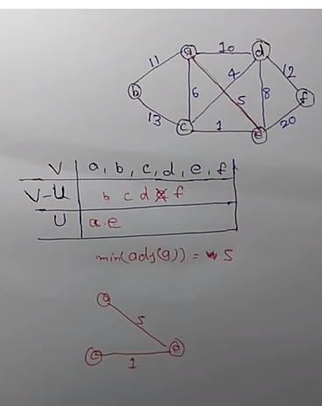

Slide 63
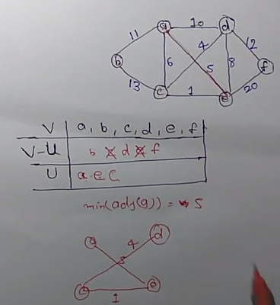

Slide 64
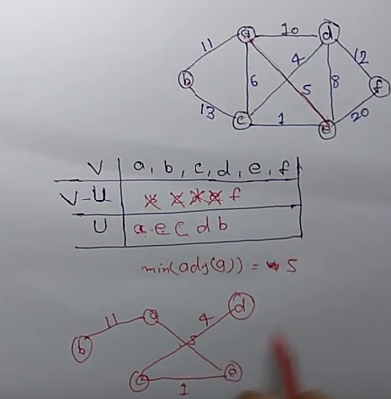

Slide 65
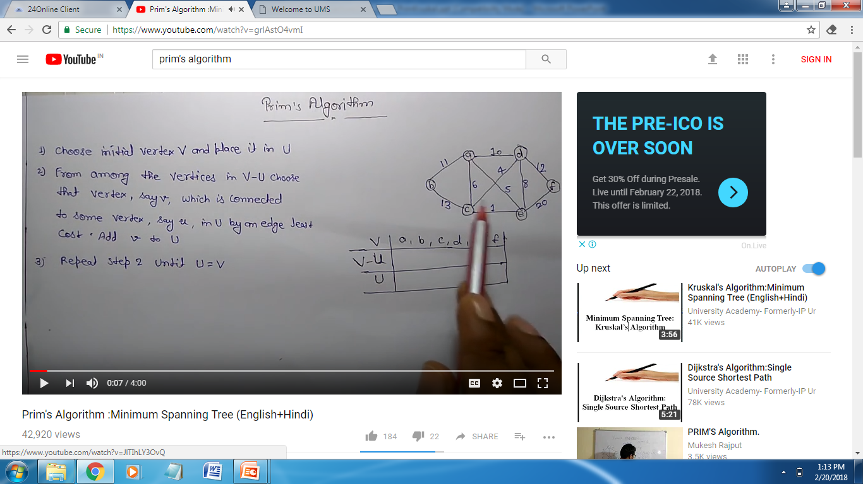


Slide 66
Kruskal’s Algorithm
Work with edges, rather than nodes
Two steps:
  Sort edges by increasing edge weight
  Select the first |V| – 1 edges that do not generate a cycle

Slide 67
Walk-Through
Consider an undirected, weight graph
F
3
C
10
A
4
3
8
4
5
B
6
D
4
4
H
2
1
3
G
E
3

Slide 68
Sort the edges by increasing edge weight
F
3
C
edge | d_{v}
(D,E) | 1
(D,G) | 2
(E,G) | 3
(C,D) | 3
(G,H) | 3
(C,F) | 3
(B,C) | 4
edge | d_{v}
(B,E) | 4
(B,F) | 4
(B,H) | 4
(A,H) | 5
(D,F) | 6
(A,B) | 8
(A,F) | 10
10
A
4
3
8
4
5
B
6
D
4
4
H
2
1
3
G
E
3

Slide 69
Select first |V|–1 edges which do not generate a cycle
F
3
C
edge | d_{v}
(D,E) | 1 | √
(D,G) | 2
(E,G) | 3
(C,D) | 3
(G,H) | 3
(C,F) | 3
(B,C) | 4
edge | d_{v}
(B,E) | 4
(B,F) | 4
(B,H) | 4
(A,H) | 5
(D,F) | 6
(A,B) | 8
(A,F) | 10
10
A
4
3
8
4
5
B
6
D
4
4
H
2
1
3
G
E
3

Slide 70
Select first |V|–1 edges which do not generate a cycle
F
3
C
edge | d_{v}
(D,E) | 1 | √
(D,G) | 2 | √
(E,G) | 3
(C,D) | 3
(G,H) | 3
(C,F) | 3
(B,C) | 4
edge | d_{v}
(B,E) | 4
(B,F) | 4
(B,H) | 4
(A,H) | 5
(D,F) | 6
(A,B) | 8
(A,F) | 10
10
A
4
3
8
4
5
B
6
D
4
4
H
2
1
3
G
E
3

Slide 71
Select first |V|–1 edges which do not generate a cycle
F
3
C
edge | d_{v}
(D,E) | 1 | √
(D,G) | 2 | √
(E,G) | 3 | χ
(C,D) | 3
(G,H) | 3
(C,F) | 3
(B,C) | 4
edge | d_{v}
(B,E) | 4
(B,F) | 4
(B,H) | 4
(A,H) | 5
(D,F) | 6
(A,B) | 8
(A,F) | 10
10
A
4
3
8
4
5
B
6
D
4
4
H
2
1
3
G
E
3
Accepting edge (E,G) would create a cycle

Slide 72
Select first |V|–1 edges which do not generate a cycle
F
3
C
edge | d_{v}
(D,E) | 1 | √
(D,G) | 2 | √
(E,G) | 3 | χ
(C,D) | 3 | √
(G,H) | 3
(C,F) | 3
(B,C) | 4
edge | d_{v}
(B,E) | 4
(B,F) | 4
(B,H) | 4
(A,H) | 5
(D,F) | 6
(A,B) | 8
(A,F) | 10
10
A
4
3
8
4
5
B
6
D
4
4
H
2
1
3
G
E
3

Slide 73
Select first |V|–1 edges which do not generate a cycle
F
3
C
edge | d_{v}
(D,E) | 1 | √
(D,G) | 2 | √
(E,G) | 3 | χ
(C,D) | 3 | √
(G,H) | 3 | √
(C,F) | 3
(B,C) | 4
edge | d_{v}
(B,E) | 4
(B,F) | 4
(B,H) | 4
(A,H) | 5
(D,F) | 6
(A,B) | 8
(A,F) | 10
10
A
4
3
8
4
5
B
6
D
4
4
H
2
1
3
G
E
3

Slide 74
Select first |V|–1 edges which do not generate a cycle
F
3
C
edge | d_{v}
(D,E) | 1 | √
(D,G) | 2 | √
(E,G) | 3 | χ
(C,D) | 3 | √
(G,H) | 3 | √
(C,F) | 3 | √
(B,C) | 4
edge | d_{v}
(B,E) | 4
(B,F) | 4
(B,H) | 4
(A,H) | 5
(D,F) | 6
(A,B) | 8
(A,F) | 10
10
A
4
3
8
4
5
B
6
D
4
4
H
2
1
3
G
E
3

Slide 75
Select first |V|–1 edges which do not generate a cycle
F
3
C
edge | d_{v}
(D,E) | 1 | √
(D,G) | 2 | √
(E,G) | 3 | χ
(C,D) | 3 | √
(G,H) | 3 | √
(C,F) | 3 | √
(B,C) | 4 | √
edge | d_{v}
(B,E) | 4
(B,F) | 4
(B,H) | 4
(A,H) | 5
(D,F) | 6
(A,B) | 8
(A,F) | 10
10
A
4
3
8
4
5
B
6
D
4
4
H
2
1
3
G
E
3

Slide 76
Select first |V|–1 edges which do not generate a cycle
F
3
C
edge | d_{v}
(D,E) | 1 | √
(D,G) | 2 | √
(E,G) | 3 | χ
(C,D) | 3 | √
(G,H) | 3 | √
(C,F) | 3 | √
(B,C) | 4 | √
edge | d_{v}
(B,E) | 4 | χ
(B,F) | 4
(B,H) | 4
(A,H) | 5
(D,F) | 6
(A,B) | 8
(A,F) | 10
10
A
4
3
8
4
5
B
6
D
4
4
H
2
1
3
G
E
3

Slide 77
Select first |V|–1 edges which do not generate a cycle
F
3
C
edge | d_{v}
(D,E) | 1 | √
(D,G) | 2 | √
(E,G) | 3 | χ
(C,D) | 3 | √
(G,H) | 3 | √
(C,F) | 3 | √
(B,C) | 4 | √
edge | d_{v}
(B,E) | 4 | χ
(B,F) | 4 | χ
(B,H) | 4
(A,H) | 5
(D,F) | 6
(A,B) | 8
(A,F) | 10
10
A
4
3
8
4
5
B
6
D
4
4
H
2
1
3
G
E
3

Slide 78
Select first |V|–1 edges which do not generate a cycle
F
3
C
edge | d_{v}
(D,E) | 1 | √
(D,G) | 2 | √
(E,G) | 3 | χ
(C,D) | 3 | √
(G,H) | 3 | √
(C,F) | 3 | √
(B,C) | 4 | √
edge | d_{v}
(B,E) | 4 | χ
(B,F) | 4 | χ
(B,H) | 4 | χ
(A,H) | 5
(D,F) | 6
(A,B) | 8
(A,F) | 10
10
A
4
3
8
4
5
B
6
D
4
4
H
2
1
3
G
E
3

Slide 79
Select first |V|–1 edges which do not generate a cycle
F
3
C
edge | d_{v}
(D,E) | 1 | √
(D,G) | 2 | √
(E,G) | 3 | χ
(C,D) | 3 | √
(G,H) | 3 | √
(C,F) | 3 | √
(B,C) | 4 | √
edge | d_{v}
(B,E) | 4 | χ
(B,F) | 4 | χ
(B,H) | 4 | χ
(A,H) | 5 | √
(D,F) | 6
(A,B) | 8
(A,F) | 10
10
A
4
3
8
4
5
B
6
D
4
4
H
2
1
3
G
E
3

Slide 80
Select first |V|–1 edges which do not generate a cycle
F
3
C
edge | d_{v}
(D,E) | 1 | √
(D,G) | 2 | √
(E,G) | 3 | χ
(C,D) | 3 | √
(G,H) | 3 | √
(C,F) | 3 | √
(B,C) | 4 | √
edge | d_{v}
(B,E) | 4 | χ
(B,F) | 4 | χ
(B,H) | 4 | χ
(A,H) | 5 | √
(D,F) | 6
(A,B) | 8
(A,F) | 10
A
3
4
5
B
D
H
2
1
}
3
G
E
not
considered
Done
Total Cost = Σ d_{v} = 21

Slide 81
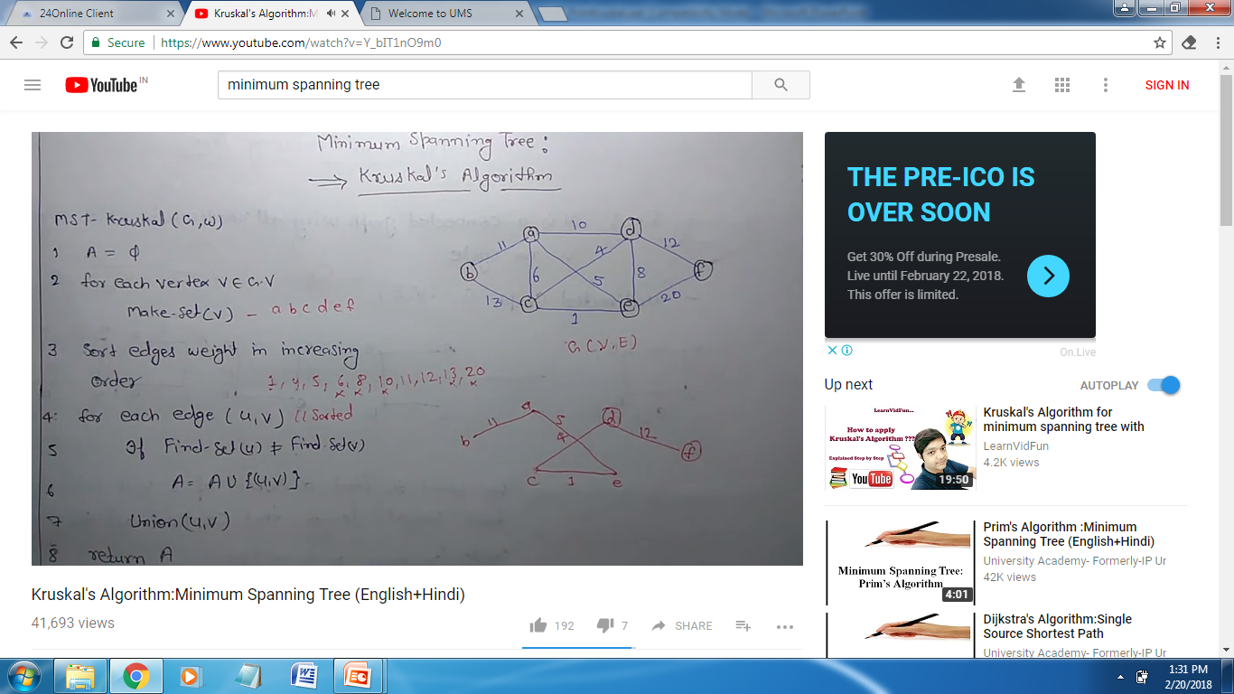

Slide 83
